Slide 1
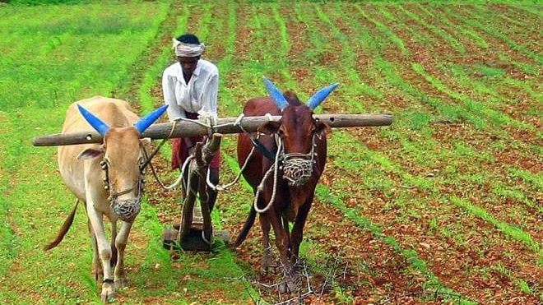
Uplifting The Farmer Through a Connected Ecosystem

Slide 2
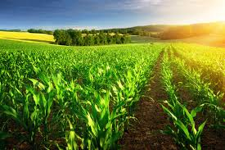
Introduction
Agriculture is the most important sector of IndianEconomy. Indian agriculture sector accounts for 18 per cent of India's gross domestic product (GDP) and provides employment to 50% of the countries workforce

Slide 3

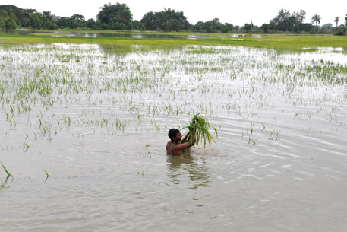
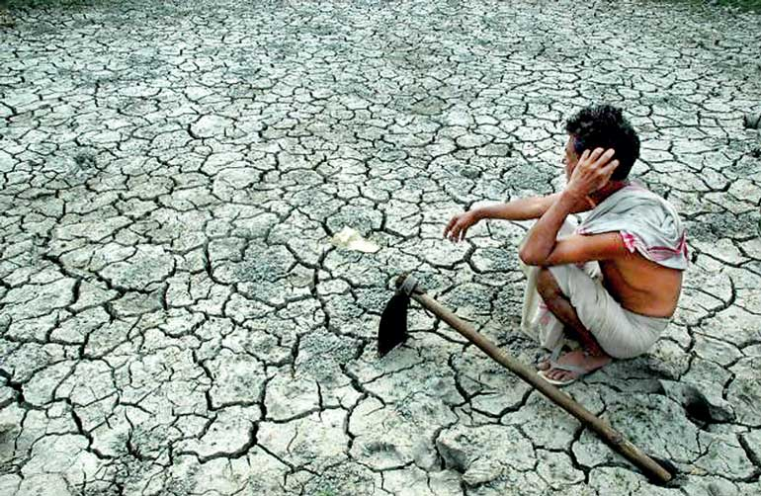
Problem statement
Problems faced by farmers during floods and drought conditions

Slide 4
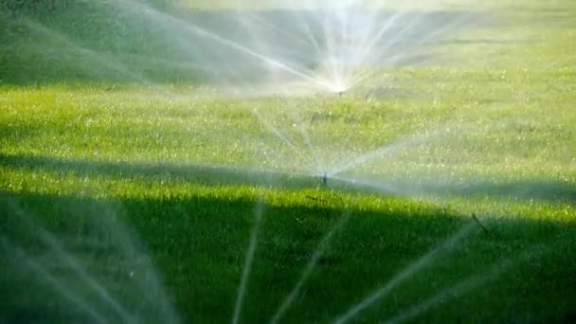

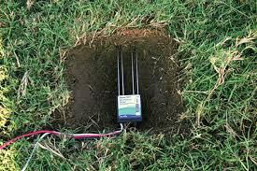
Objective
Moisture sensor is used to sense the moisture content and according to the moisture level either water is sprinkled is or water is collected.

Slide 5
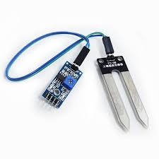
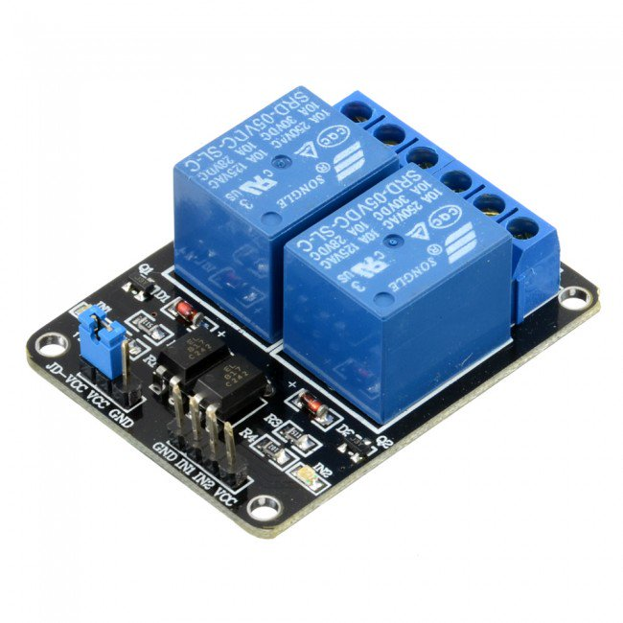
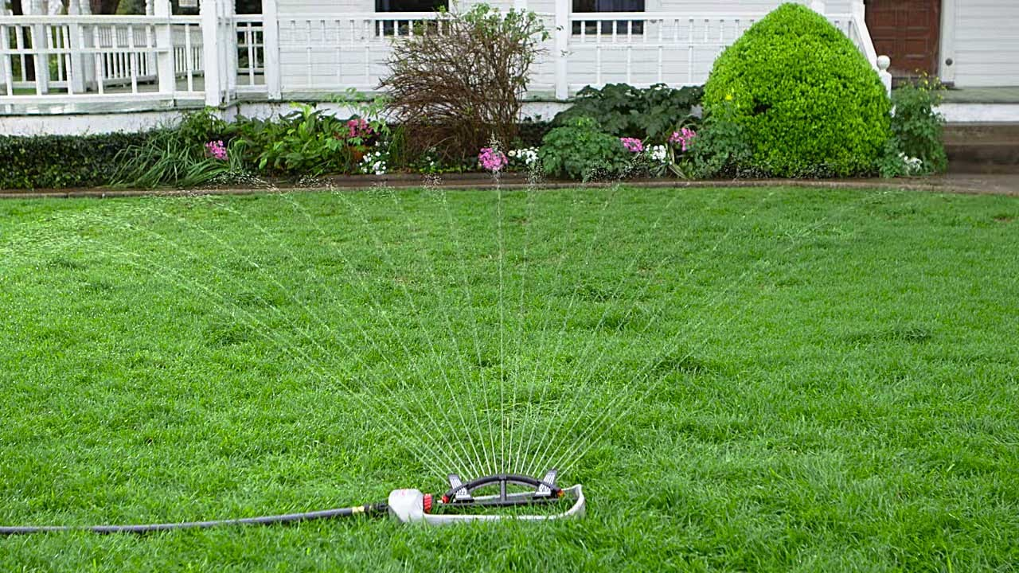
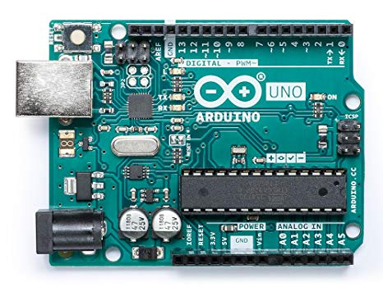
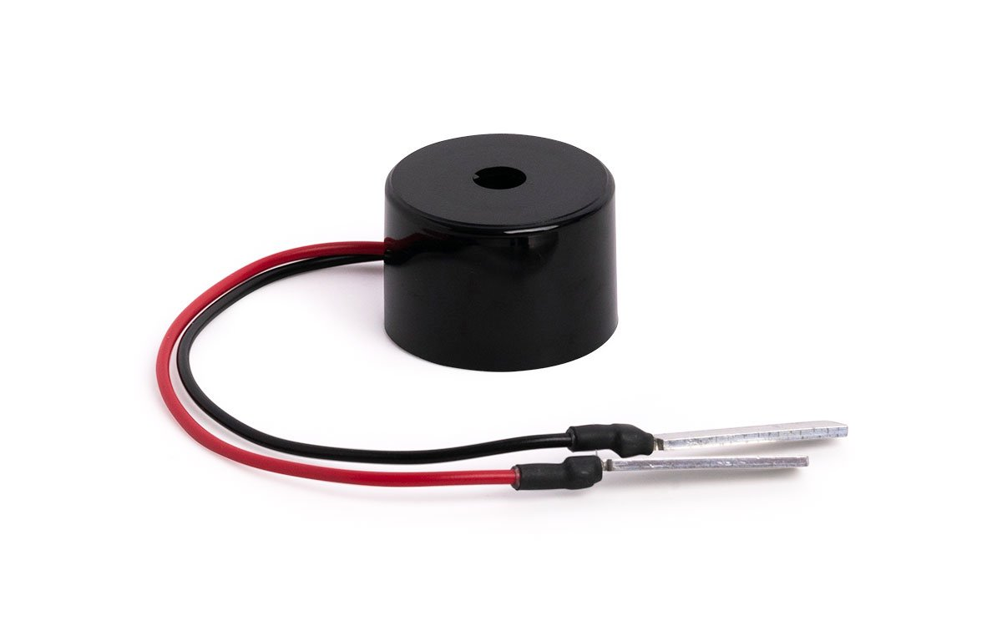
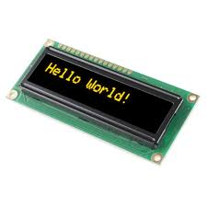
Requirements
Arduino Uno
Moisture sensor
Relay modules
Sprinklers
LCD display
Buzzer

Slide 6
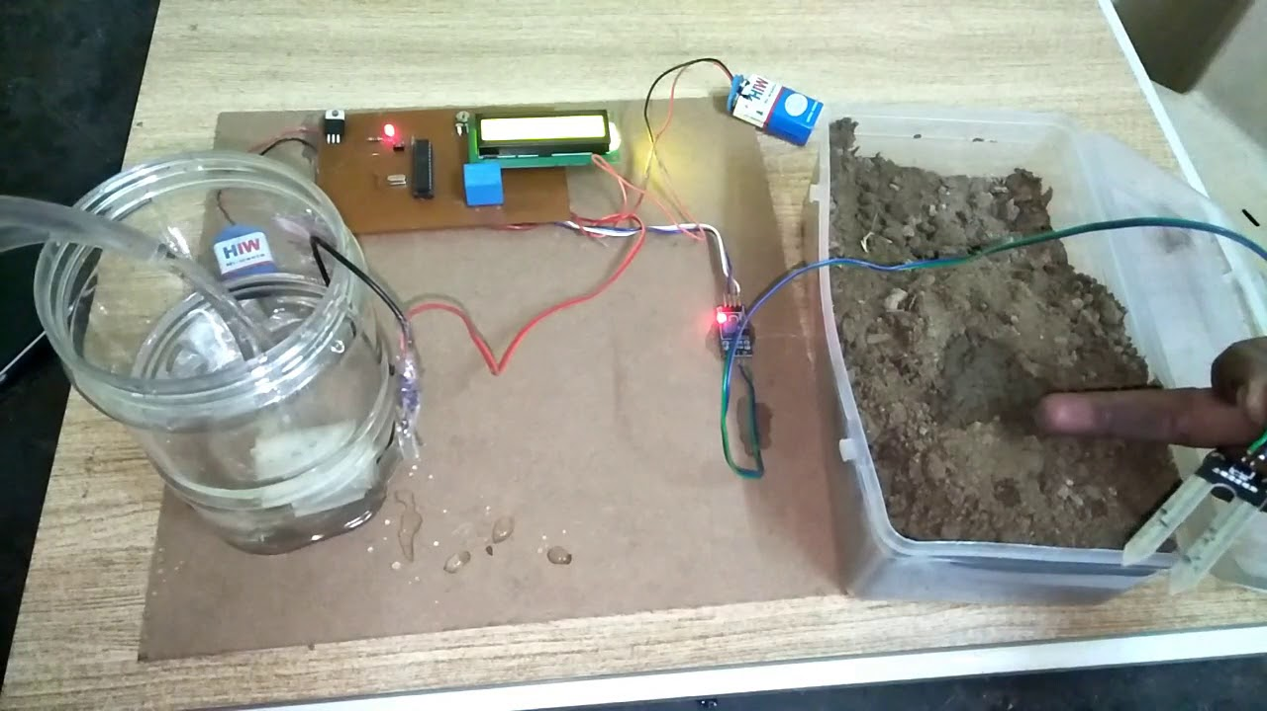
Description
Moisture sensor senses the moisture content of the soil.
If the moisture content is less a buzzer sound is produced automatically then automatic sprinklers are used to sprinkle water to the fields.
Else the water is collected from the field.

Slide 7
Evidence
Dusari upender (30 acres)
Contact no:
9346480410
9502288151
Karu Venkatram Reddy(70 acres)
Contact no:9483697759
N,Verrana(19 acres)
Contact no:
8374417328

Slide 8

Review
They liked our project and only the question they raised is that about the working of moisture sensors and the number of sensors required for an acre of land.
The cost of the project.

Slide 9
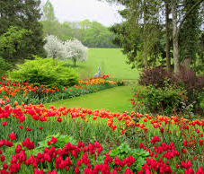
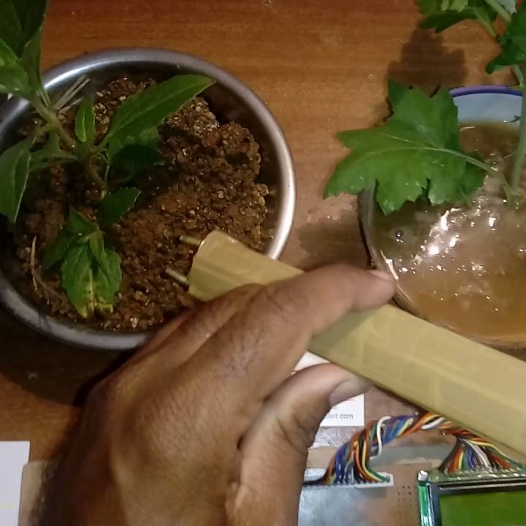
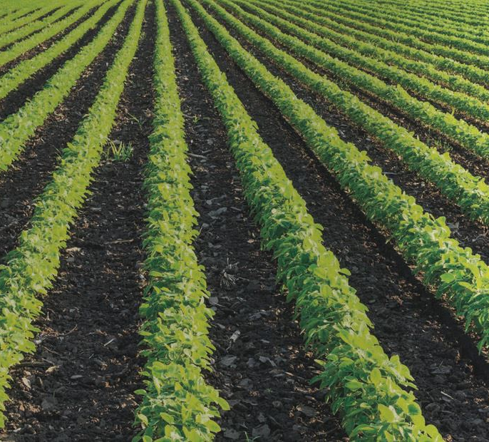
Applications
Gardens
Fields
Flower pots

Slide 10

By:
P.Ankitha
K.SaiChandrika
A.Mahalakshmi

